Slide 1


C. Liu
28 May 2024

Slide 2

Outline
Executive Summary
Introduction
Methodology
Results
Conclusion
Appendix

Slide 3
Executive Summary
Summary of Methodologies
The present research aims to determine the success rate of the first stage of land to predict if SpaceX is able to reuse the first stage. To do this, the following methodologies were employed:
Collect data using SpaceX REST API and webscraping techniques
Wrangle data
Analyze and explore data with 1) SQL and 2) data visualization techniques
Visualize launch sites and their geographical proximity to significant markers (e.g., coastlines, highways)
Investigate launch sites with the most success and its relation to payload mass
Build models to predict landing outcomes
Summary of Results
Overall, launch success has improved over time, with KSC LC-39A having the highest success rate among landing sites. Most launch sites are near the equator and near coastlines. The decision tree model was found to perform better on test site among all models tested.

Slide 4
Introduction
Background
SpaceX is a leading innovator in the space industry, with accomplishments such as sending spacecraft to the ISS, providing satellite Internet access, and sending manned missions to space. SpaceX is able to accomplish these rocket launches at a cost of 62 million dollars; other competitors are only able to carry out launches at 165 million dollars. Much of the savings is because SpaceX is able to reuse the first stage. Therefore, if we can determine and predict if the first stage will land (and can then be reused), we can determine the cost of a launch.
Questions
How much does each launch cost?
How do factors such as payload mass, launch sites, flights, and orbit impact landing success?
What is the rate of successful landings over time?
What is the best predictive model for successful landing?

Slide 5

Section 1

Slide 6
Methodology
Executive Summary
Data collection methodology:
Perform data wrangling
Perform exploratory data analysis (EDA) using visualization and SQL
Perform interactive visual analytics using Folium and Plotly Dash
Perform predictive analysis using classification models

Slide 7
Data Collection – SpaceX API
Request rocket launch data from SpaceX API
Parse the data using the GET request
Turn data into a dataframe using .json_normalize()
Use API to get information about the launches, then create dictionary with data
Create dataframe from the dictionary
Filter the dataframe to only include Falcon 9 launches
Replace missing values with the average
Export data to csv file

Slide 8
Data Collection – Webscraping
Request Falcon 9 launch data from Wikipedia
Create BeautifulSoup object from HTML response
Extract column names and data from the HTML tables
Create dictionary from extracted data
Create dataframe from the dictionary
Export data to csv file

Slide 9
Data Wrangling
Calculate…
Number of launches on each site
Number and occurrence of each orbit
Number and occurrence of mission outcome of orbits
TRUE OCEAN – successfully landed to specific region in ocean
FALSE OCEAN –unsuccessfully landed to specific region in ocean
TRUE RTLS – successfully landed to ground pad
FALSE RTLS – unsuccessfully landed to ground pad
TRUE ASDS – successfully landed to drone ship
FALSE ASDS – unsuccessfully landed to drone ship
NONE ASDS / NONE NONE – failure to land
Create landing outcome label from the Outcome column where 0 = failure to land, 1 = successful landing

Slide 10
EDA with Data Visualization
Create scatter (relationships) or bar (comparisons) charts for:
Flight number vs. payload
Flight number vs. launch site
Payload mass vs. launch site
Payload mass vs. orbit type

Slide 11
EDA with SQL
Queries performed with SQL
Names of unique launch sites
Launch sites that began with “CCA”
Total payload mass of boosters launched by NASA (CRS)
Average payload mass of booster version F9 v1.1
Date of first successful landing on ground pad
Names of boosters with successful drone ship landings and payload mass between 4,000 – 6,000 kg
Total number of successful and failed missions
Booster versions that have carried maximum payload mass
Names of boosters and launch sites with failed drone ship landings during the months of 2015
Count of landing outcomes between 2010-06-04 and 2017-03-20

Slide 12
Build an Interactive Map with Folium
First, added markers indicating launch sites
Blue circle at NASA Johnson Space center’s coordinates, and red circles around all launch sites
Popup labels showing name and coordinates for all launch sites
Then, added markers indicating the outcomes of the launches
Colored markers indicating successful (green) and unsuccessful (red) launches
Finally, added lines to distance
Colored lined to show distance between launch site (28.56234, -80.57737) and proximity to nearest coastline and highway

Slide 13
Build a Dashboard with Plotly Dash
Dropdown list with launch sites
Pie chart displaying successful launches
Slider for payload mass range
Scatter graph investigating relationship between mass vs success rate

Slide 14
Predictive Analysis (Classification)
Create NumPy array
Standardize data, then fit and transform
Split data into test and training sets
Create GridSearchCV object with cv=10 and apply on different algorithms:
Logistic regression
Support vector machine
Decision tree
K-nearest neighbour
Calculate accuracy and create confusion matrix for all test data to identify best model

Slide 15

Section 2

Slide 16
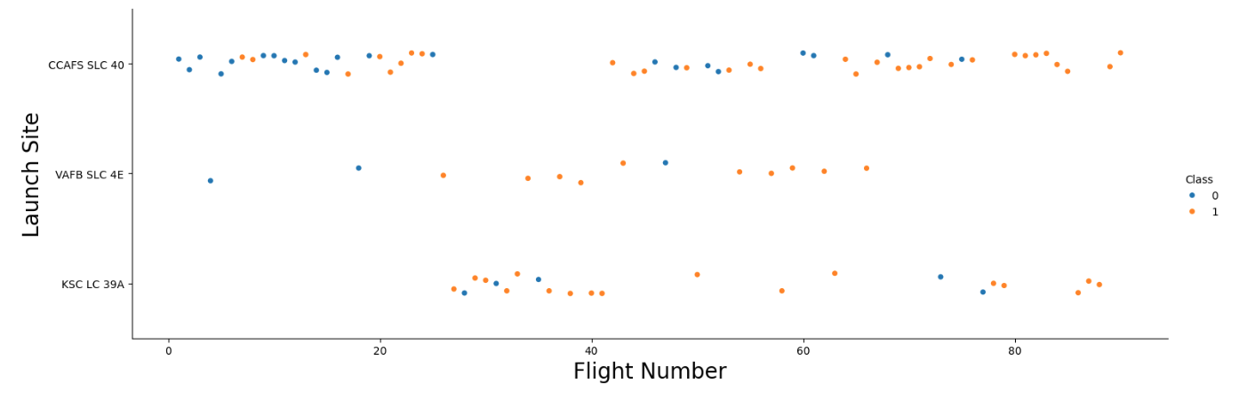
Flight Number vs. Launch Site
Earlier flights tended to have lower success rates while later flights tended to have higher success rates.

Slide 17
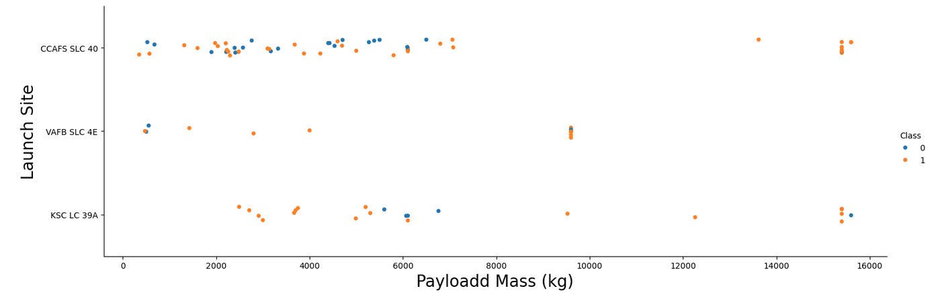
Payload vs. Launch Site
Most launches greater than 8000kg were successful. Most failed launches occurred between 0 to 6000 kg payload masses. KSC LC 39A had the fewest failed launches across all payload masses.

Slide 18
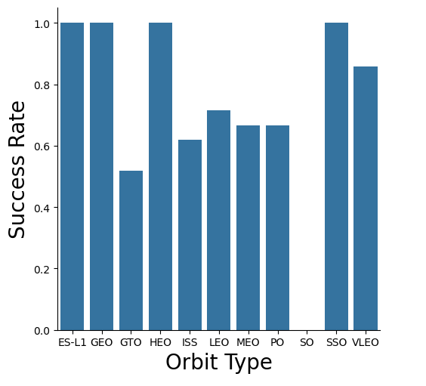
Success Rate vs. Orbit Type
ES-L-1, GEO, HEO, and SSO orbits all had success rates of 100%. On the other end of the spectrum, SO had a success rate of 0%.

Slide 19
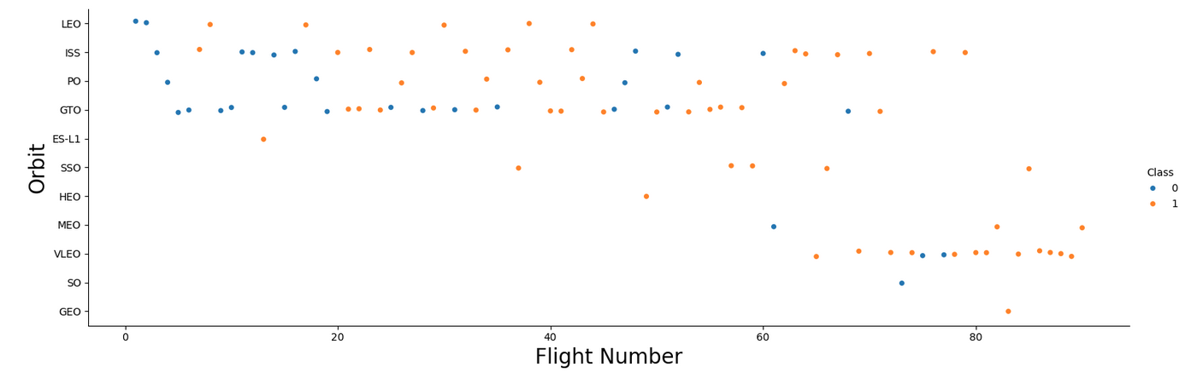
Flight Number vs. Orbit Type
Success rate tends to increase as number of flights per orbit increases. Most failed launches occurred during earlier flights.

Slide 20
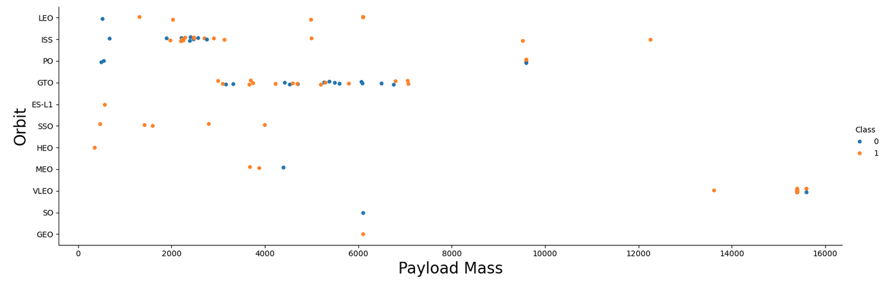
Payload vs. Orbit Type
Mixed success rates across payloads, but particularly with GTO orbits and GS orbits.

Slide 21
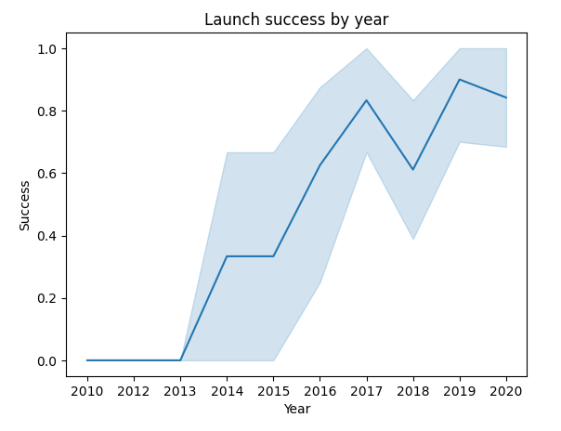
Launch Success Yearly Trend
Overall, the success rate has improved dramatically from 2013 to 2020. There was a dip in success between 2017 and 2018, but success rate quickly recovered the following year.

Slide 22
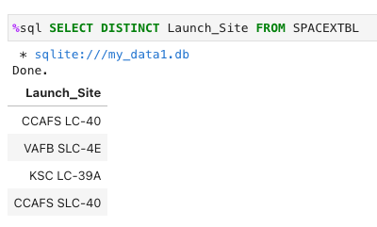
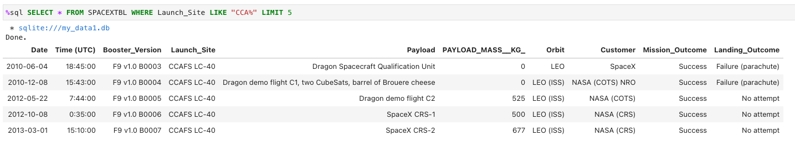
Launch Site Information
Launch site names:
CCAFS LC-40
VAFB SLC-4E
KSC LC-39A
CCAFS SLC-40
5 records of launch sites starting with “CCA”

Slide 23
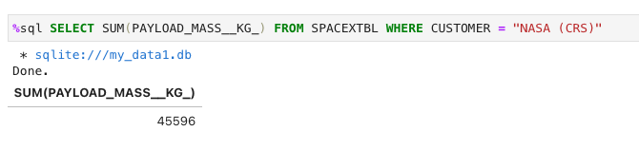
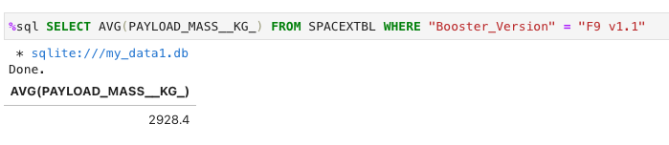
Payload Mass
Total payload mass of 45,596 kg carried by boosters launched by NASA
Average payload mass of 2928 kg carried by booster version F9 v1.1

Slide 24
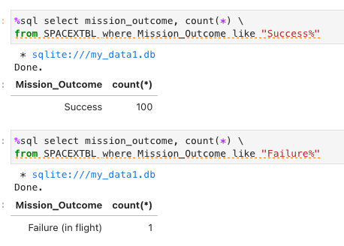
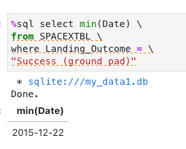
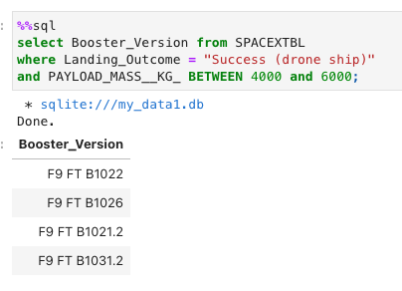
Landing and Mission Outcomes
First successful landing in ground pad on Dec 22, 2015
Successful drone ship landing with booster versions (B1022, B1026, B1021.2, B2031.2) with payload mass between 4000 and 6000 kg
100 successful mission outcomes, 1 failed mission outcome

Slide 25
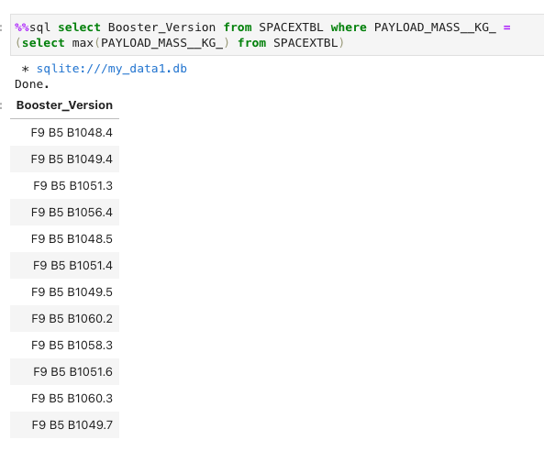
Boosters Carried Maximum Payload
12 booster versions that have carried the maximum payload

Slide 26
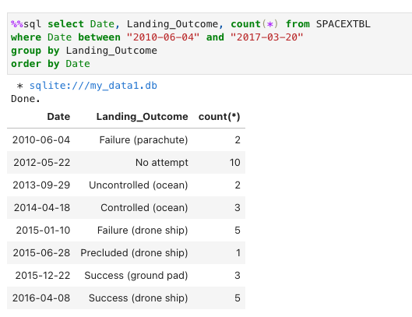
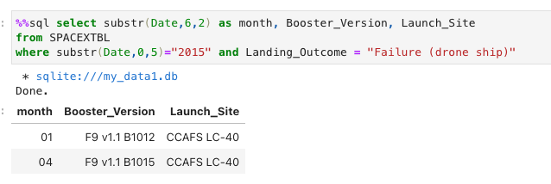
Launch Records
Two launches with unsuccessful landings on drone ships: in January and in March
Count of successful landings between 2010-06-04 and 2017-03-20 in descending order by date

Slide 27

Section 3

Slide 28
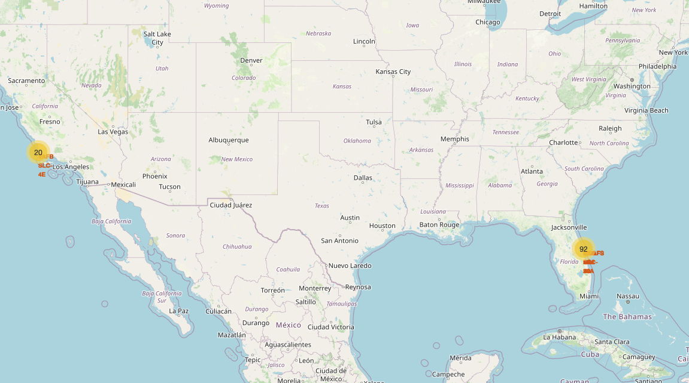
Launch Sites
Launch sites are located near the equator and along the two coasts.

Slide 29
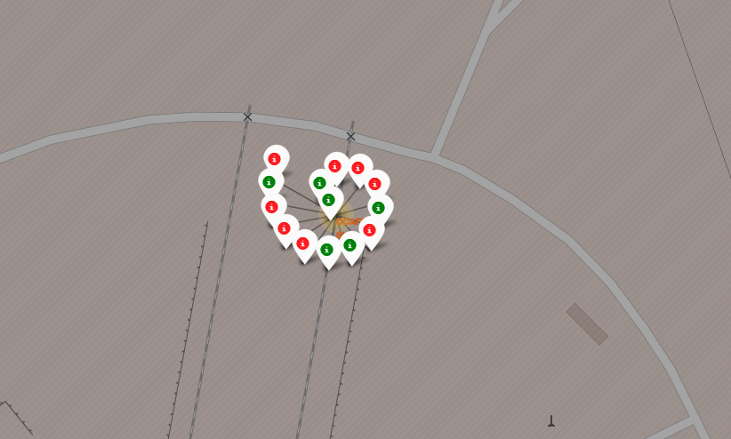
Launch Outcomes
Green markers indicate successful launch, red markers indicate failed launch.

Slide 30
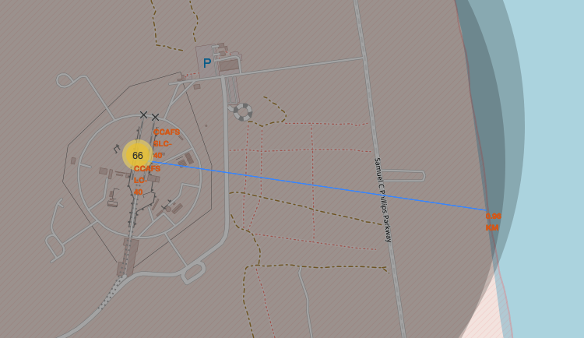
Distance to Proximities
Launch site CCAF SLC-40 is located approximately 0.96km from the coast

Slide 31

Section 5

Slide 32
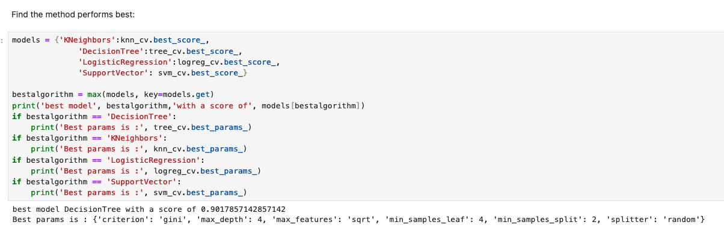
Classification Accuracy
Decision tree model had the highest .best_score_ accuracy

Slide 33
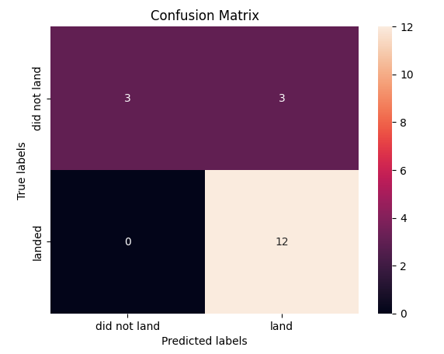
Confusion Matrix
Summarizes the performance of the Decision Tree classification model
Results of the confusion matrix: 12 true positives, 3 false positives, 3 true negatives, and 0 true negatives

Slide 34
Conclusions
Success rate of launches has increased since 2013
KSC LC-39A has had the most successful launches across all sites
Orbits ES-L1, GEO, HEO, SSO, VLEO had 100% success rates
Prediction models operated at relatively similar levels of accuracy, but the Decision Tree model did outperform the others slightly
Launch sites were located near the equator and along the two coasts

Slide 35


